Slide 1
Suma: an open-source toolkit for library assessment
Jason Casden
Bret Davidson
North Carolina State University Libraries

Slide 2
Problem statement
Many libraries perform manual counts of people in spaces doing something at some time
The process involves tedious collection mechanisms, lots of paperwork, and much room for error
There is no coordinated effort to help departments analyze their data

Slide 3
Our solution
An open source tablet-based app (well, toolkit) to aid library staff in assessment of how patrons are using library spaces.
In other words…the gathering, storing, exporting, analyzing, and visualizing of data across spaces/activities/time and around events.

Slide 4
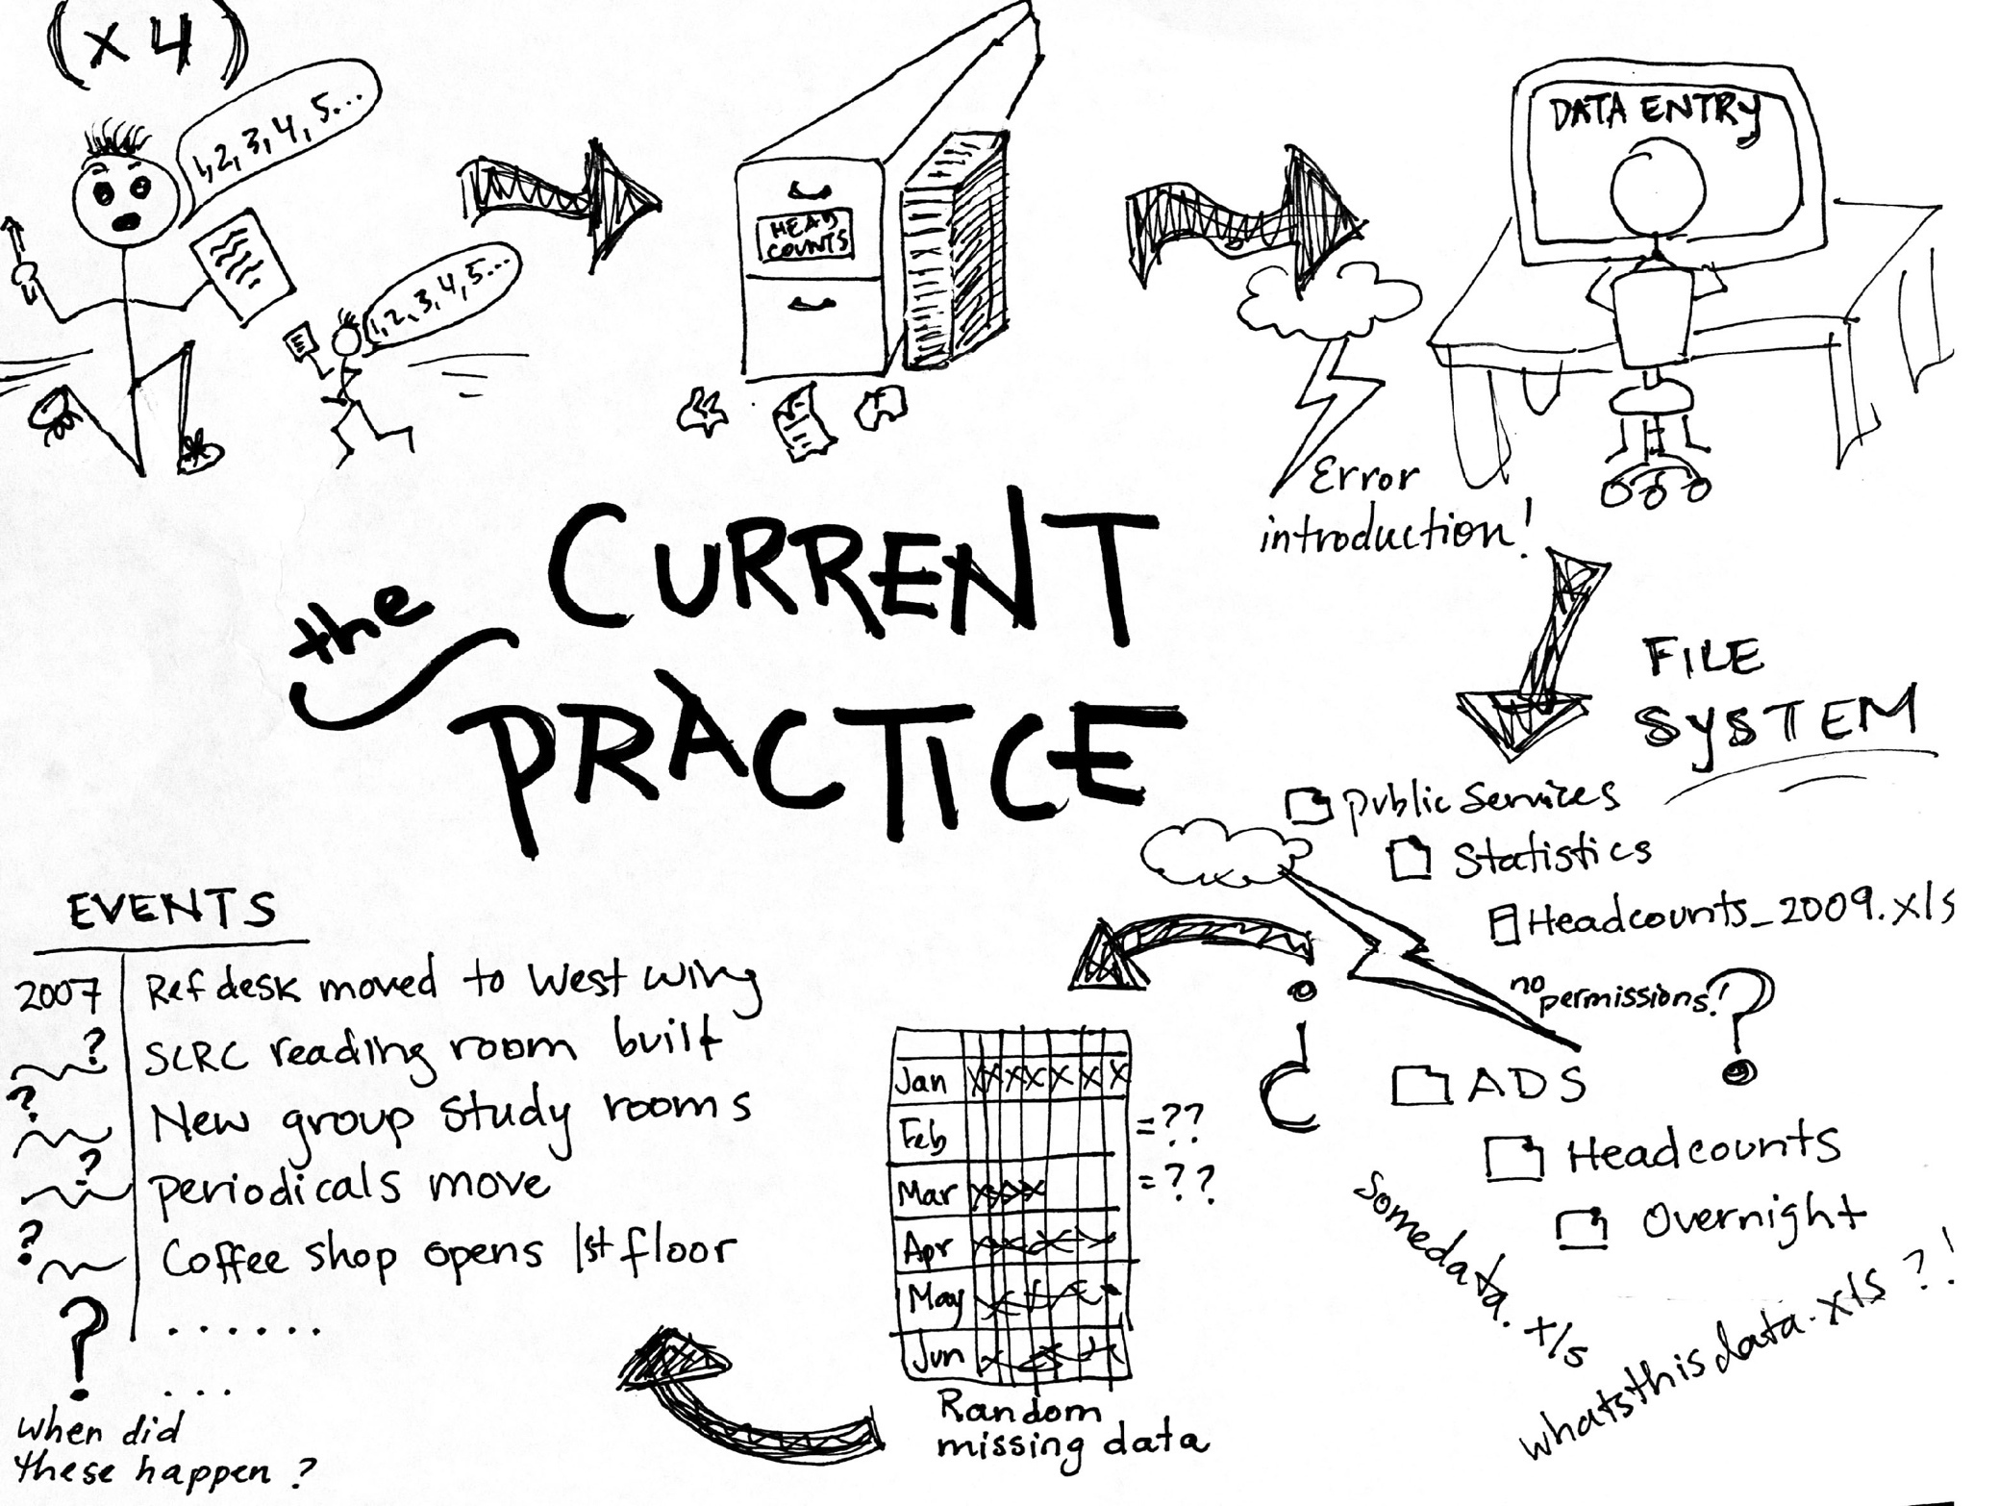
Illustration by Joyce Chapman

Slide 5
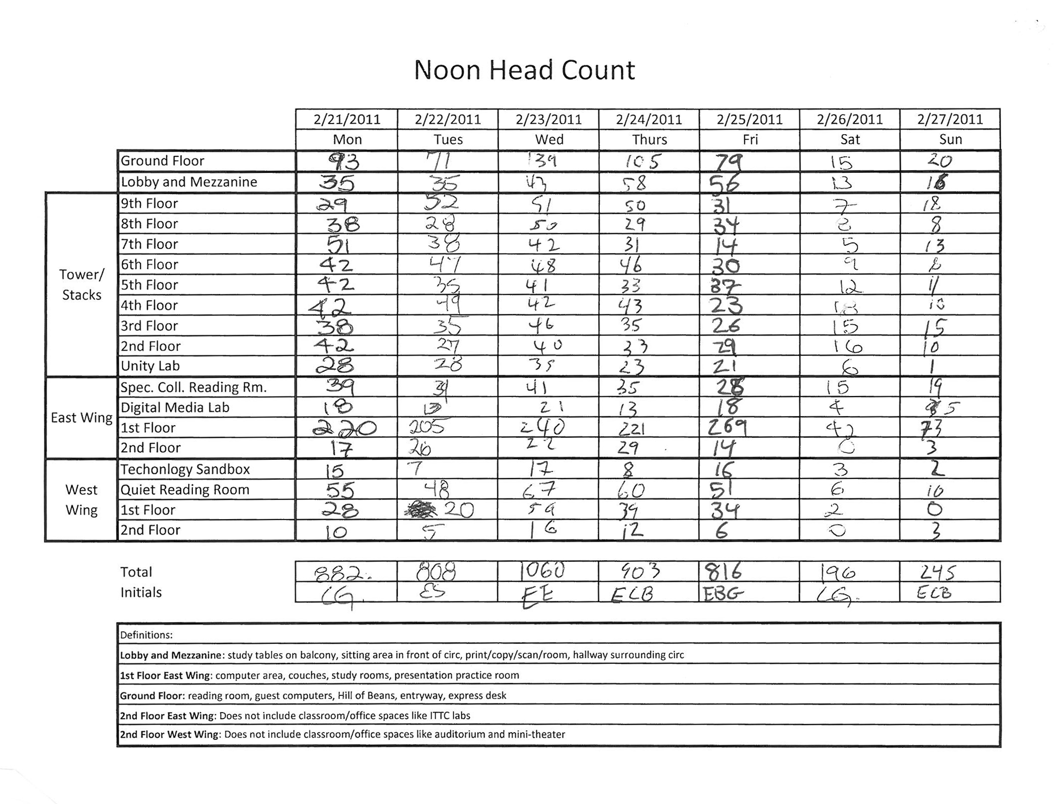

Slide 6
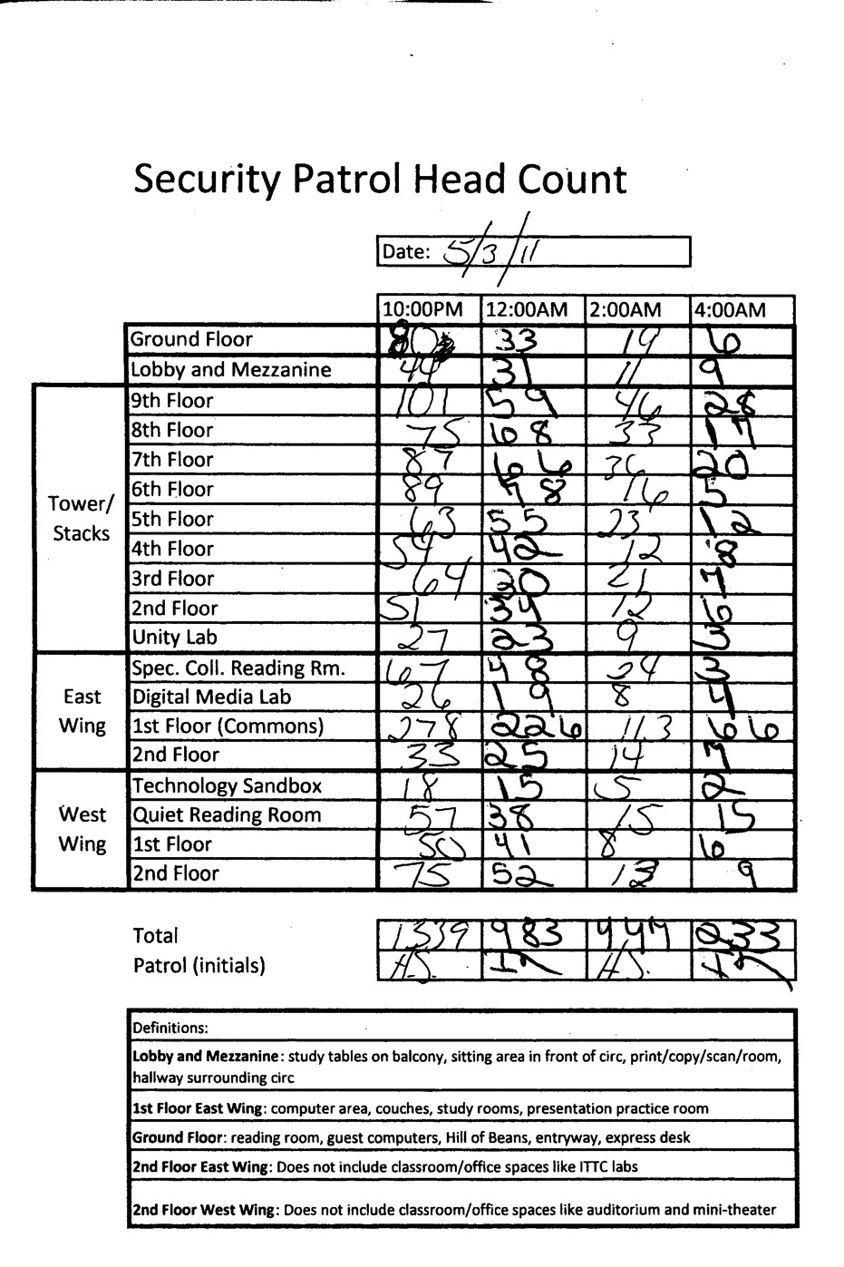

Slide 7
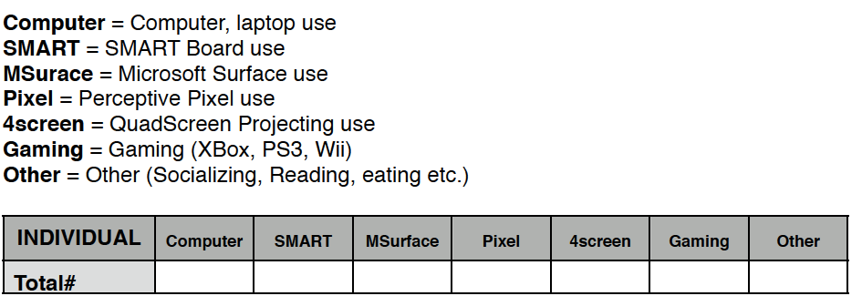

Slide 8
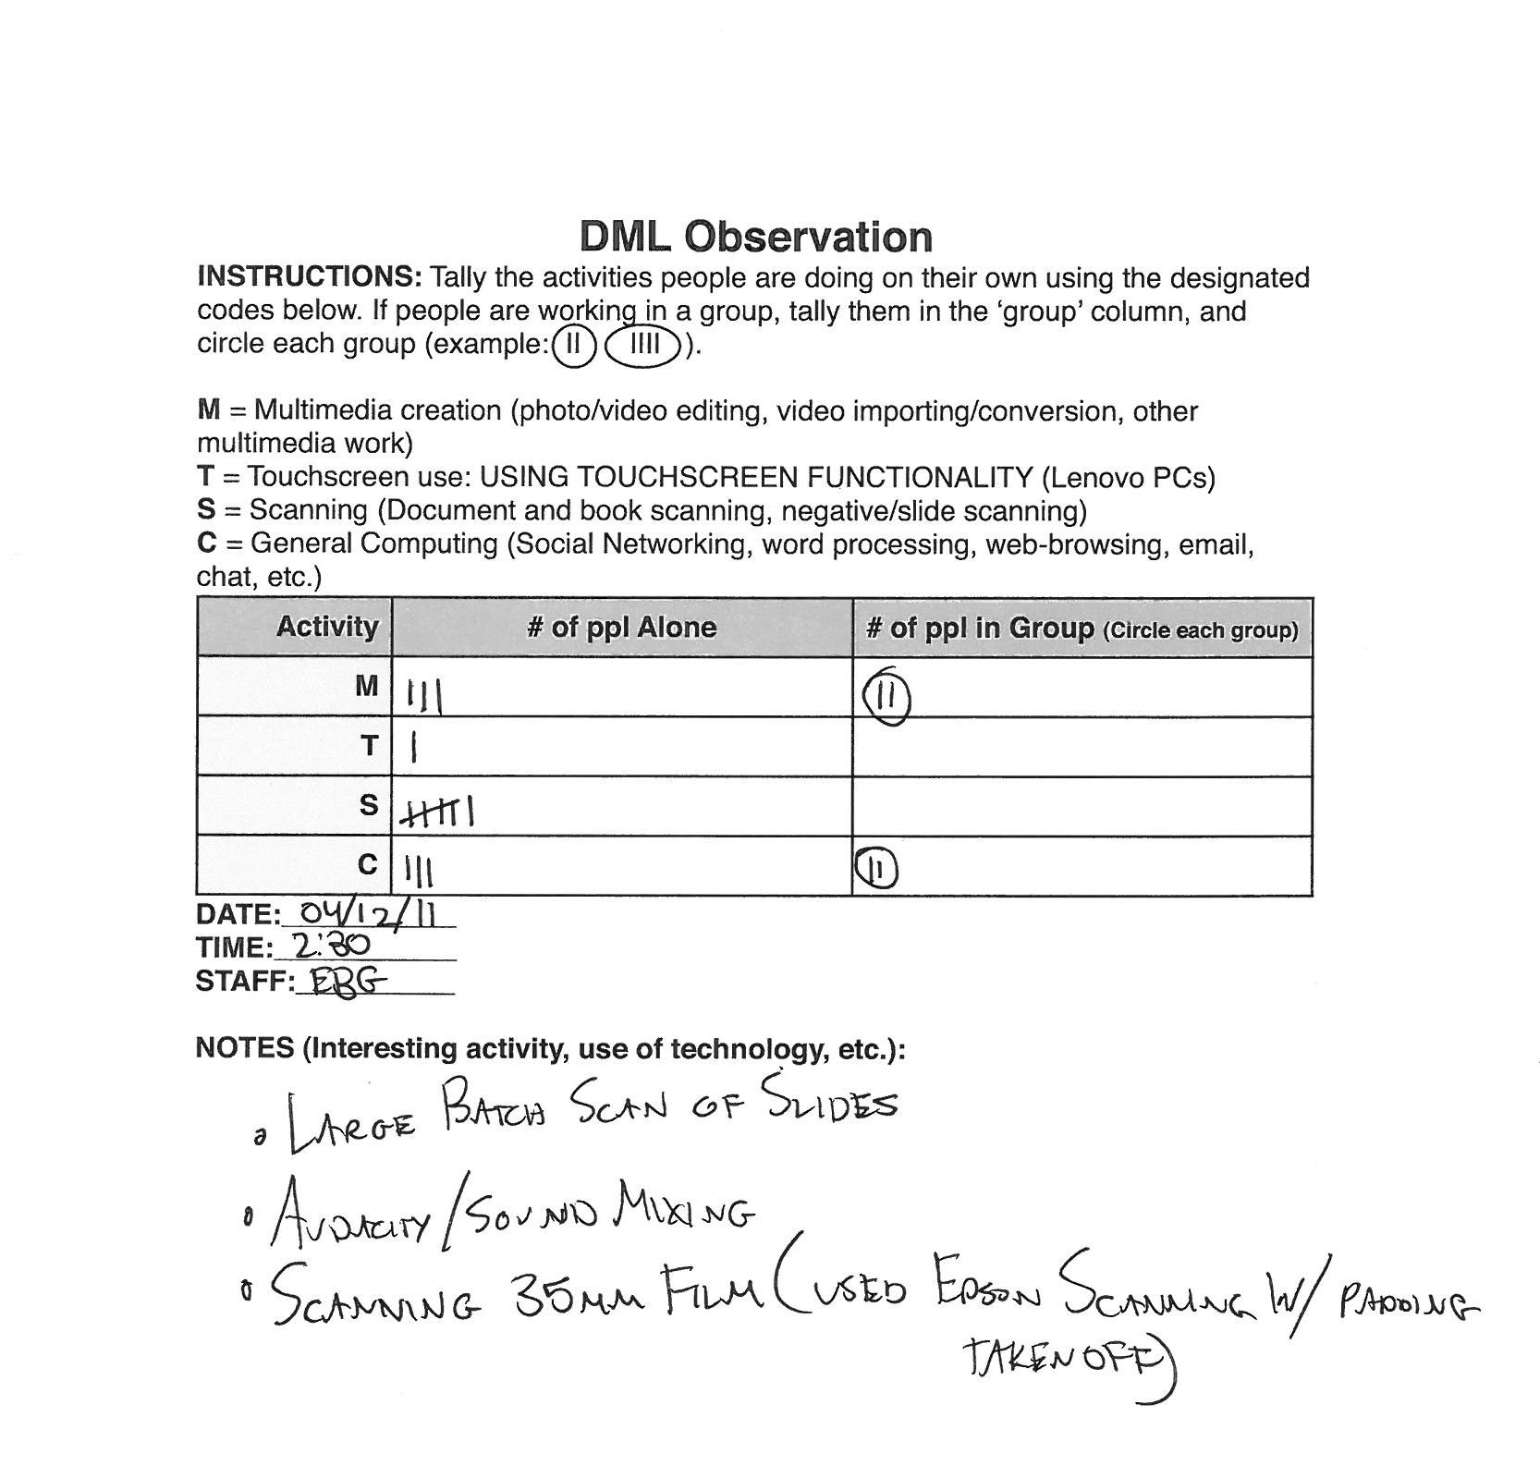

Slide 9
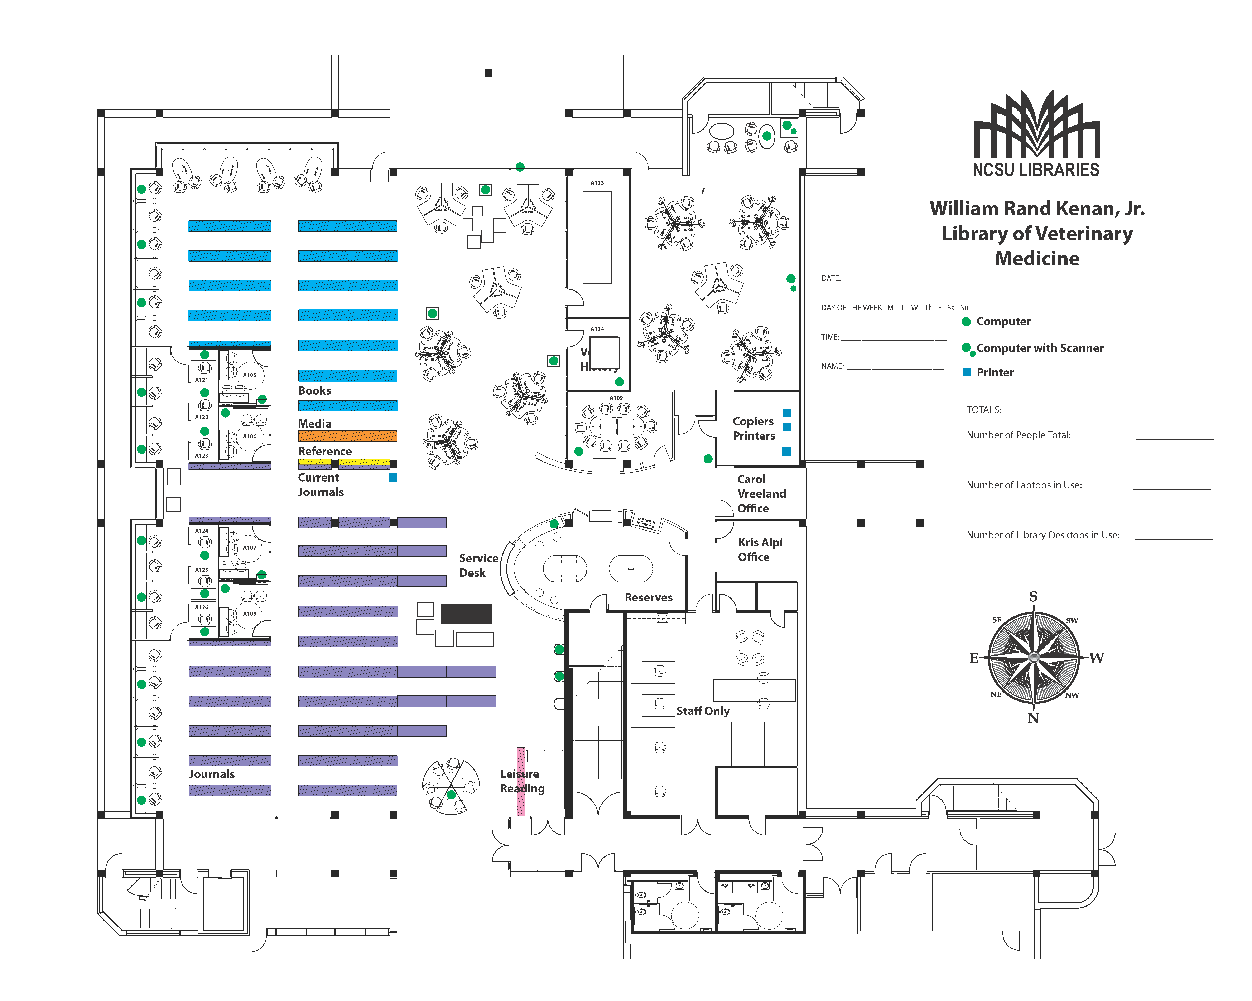

Slide 10
Activity tracking
Are some spaces more conducive to group study or individual study?
What’s the ratio of usage of laptops versus public computers versus no computers?
Do changes to space components change the type of usage?

Slide 11
New in the last year

Slide 12
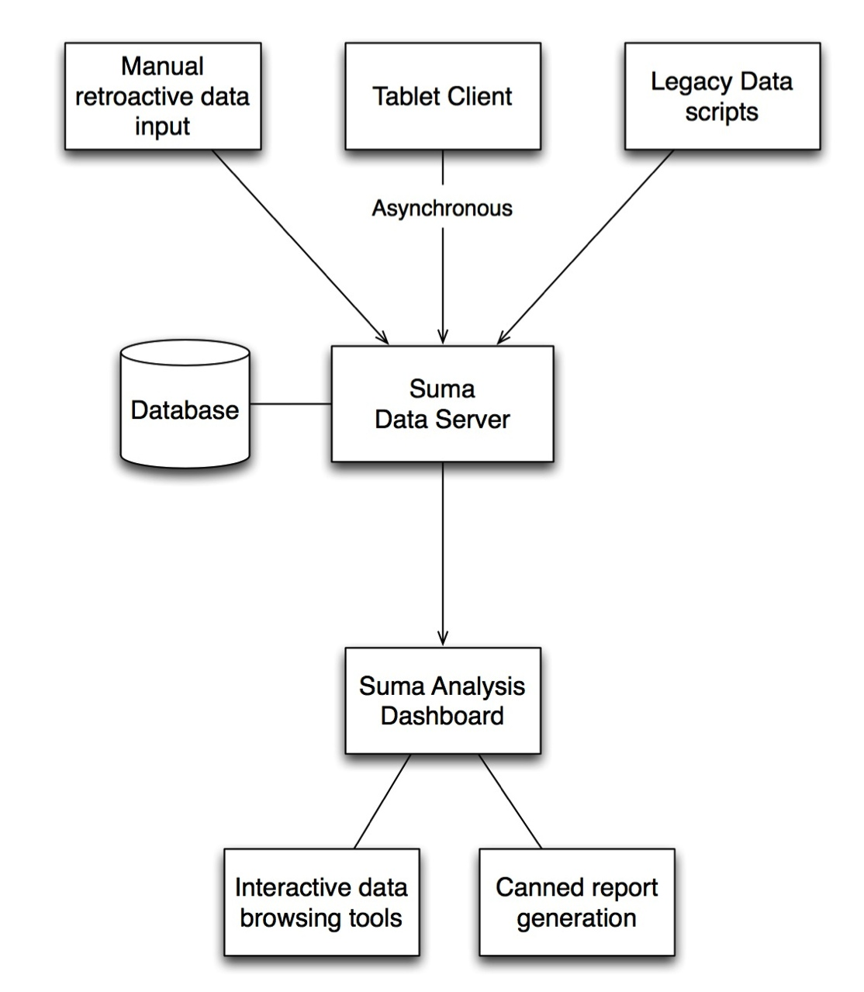
What is the system?

Slide 13
What is the system?

Slide 14
What is the system?
We talked about this last year.

Slide 16
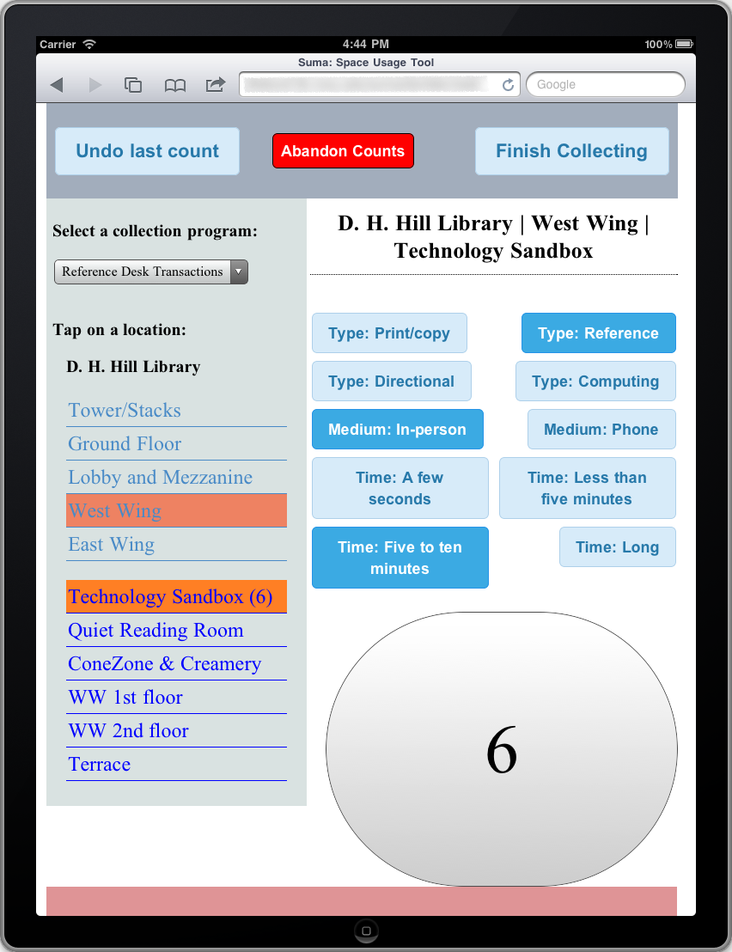

Slide 17
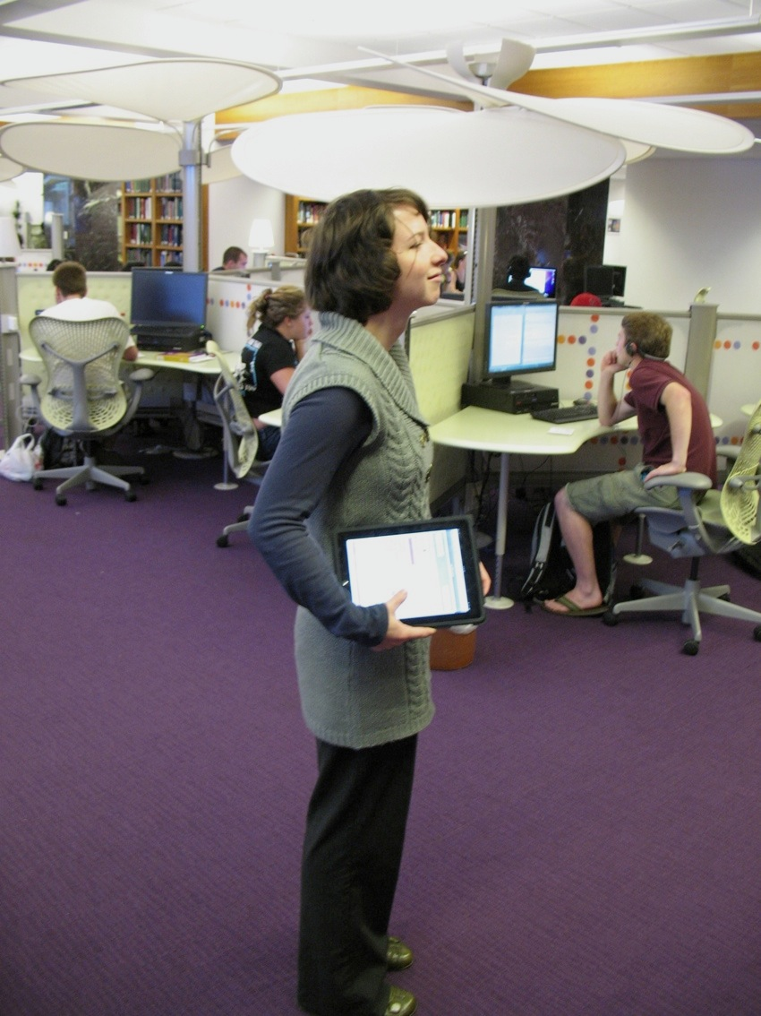
Staff as sensors
Joyce Chapman: librarian, project team member, slide contributor, wireframer, data analyst, illustrator.

Slide 18
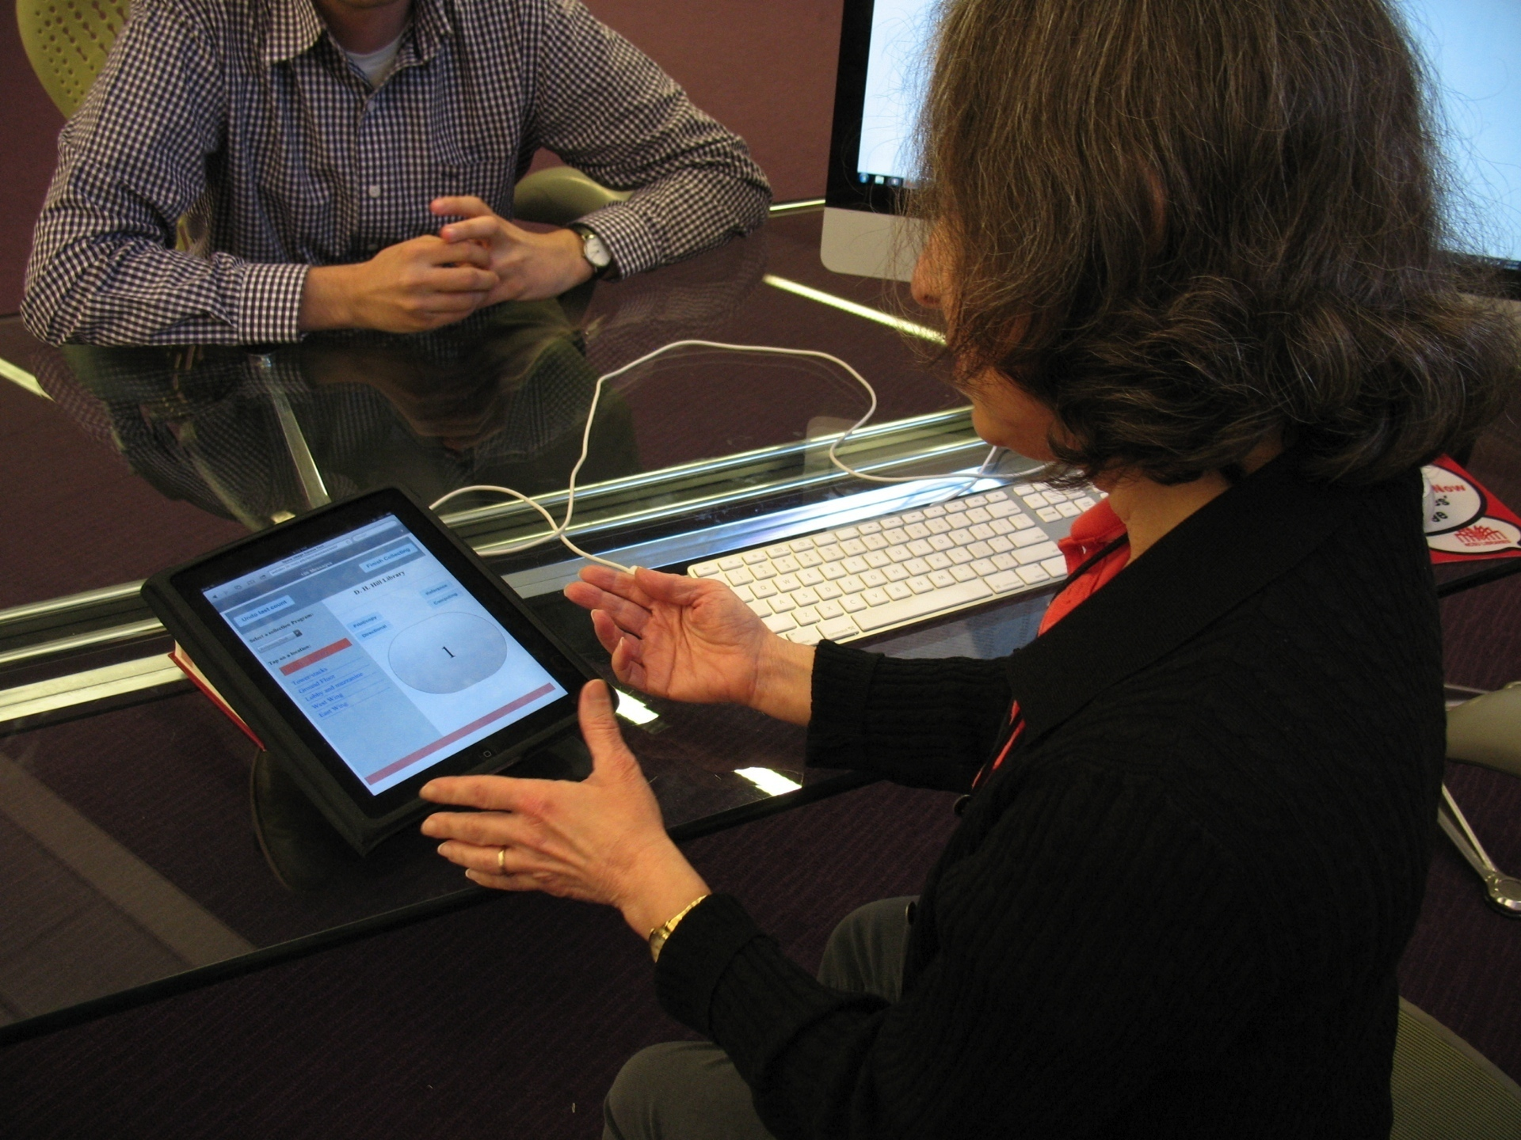

Slide 19
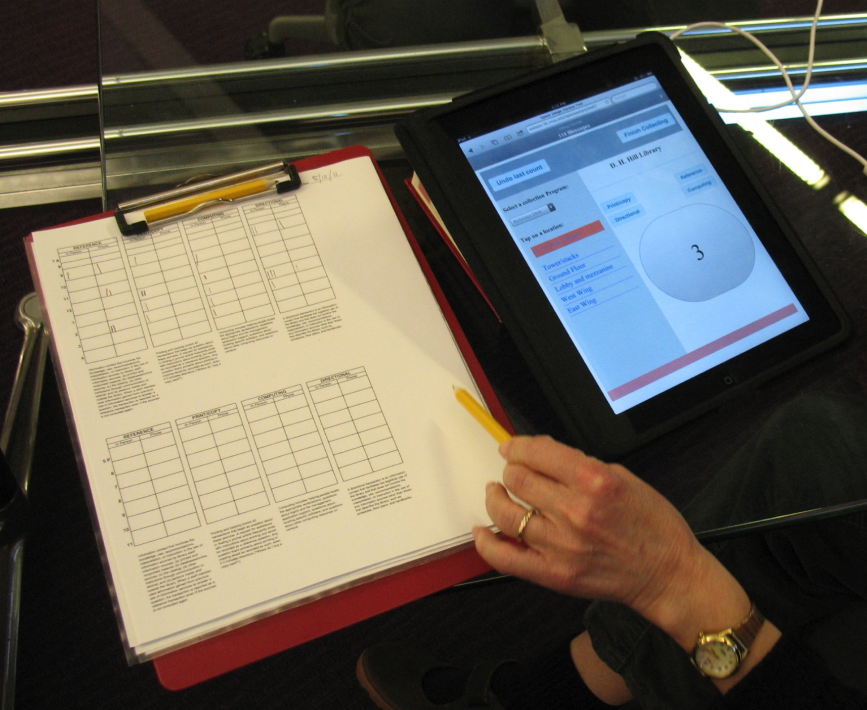

Slide 20
What is the system?

Slide 21
This actually works now (notes)
Manage initiatives, locations, and activities
Normalize, backup data
Performance-optimized data querying web service
Documentation
Open-source release

Slide 22
Thanks, Eric!

Slide 23
What is the system?

Slide 24
Section themes
Show-off visualizations
User questions we hope to answer
Viz principles
Data to ink ratio
Focus on answering questions
Multiple views on the same data
Interactive usage
Mention d3, principles of using native browser tools
Suma architectural benefits (decoupling analysis from server)
Future plans
CSV output
Proportional activity views
Experimental viz

Slide 25
Visualization Principles
Focus on answering real questions
Interactive usage
Multiple views of same data
Apply best practices
High “data to ink” ratio
Don’t distort data
Tufte, Few, etc.

Slide 26
Questions
Are there trends in usage across different spaces?
How does one semester compare to another?
Which locations support which activities?
What reference transactions are being supported most?

Slide 27
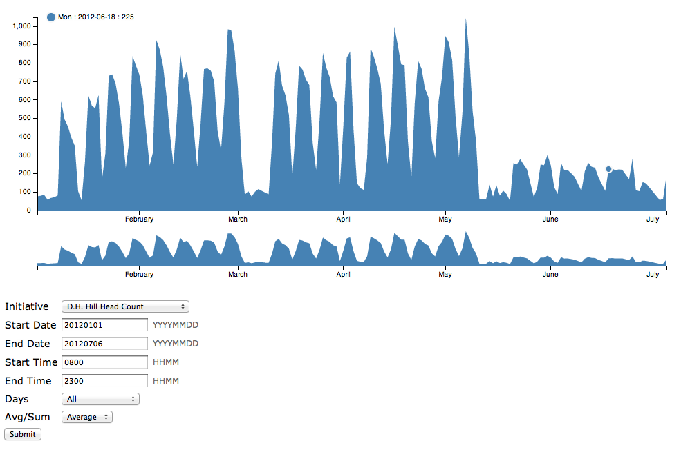

Slide 28
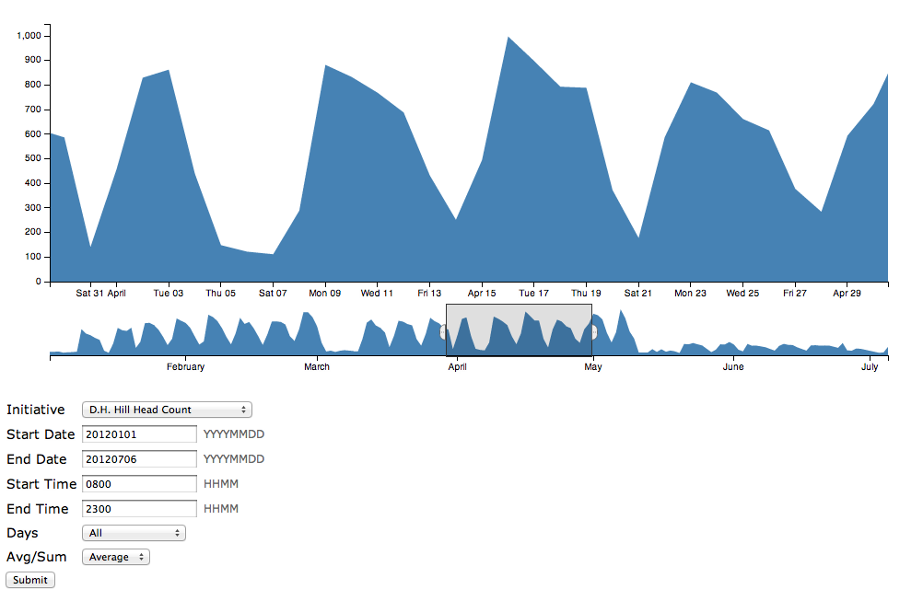

Slide 29
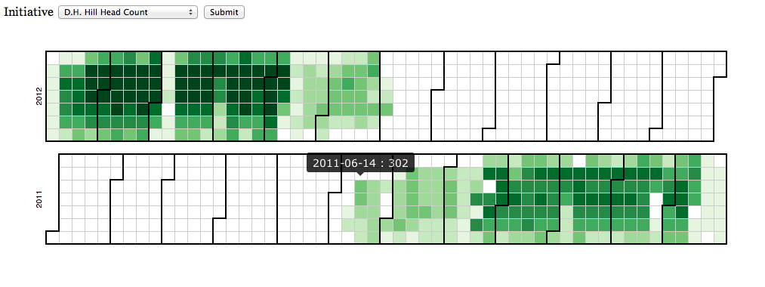

Slide 30
Browser Based Tools
D3.js => d3js.org
SVG
Advantages
Interactive
Portable
Known technologies

Slide 31
Suma Architecture
Analysis is decoupled from Server
Use what you want!
Google Charts
Processing
Raphael
http://selection.datavisualization.ch/

Slide 32
Future Analysis
CSV export of selected data
Proportional analysis of activities
Experimental Visualizations

Slide 33
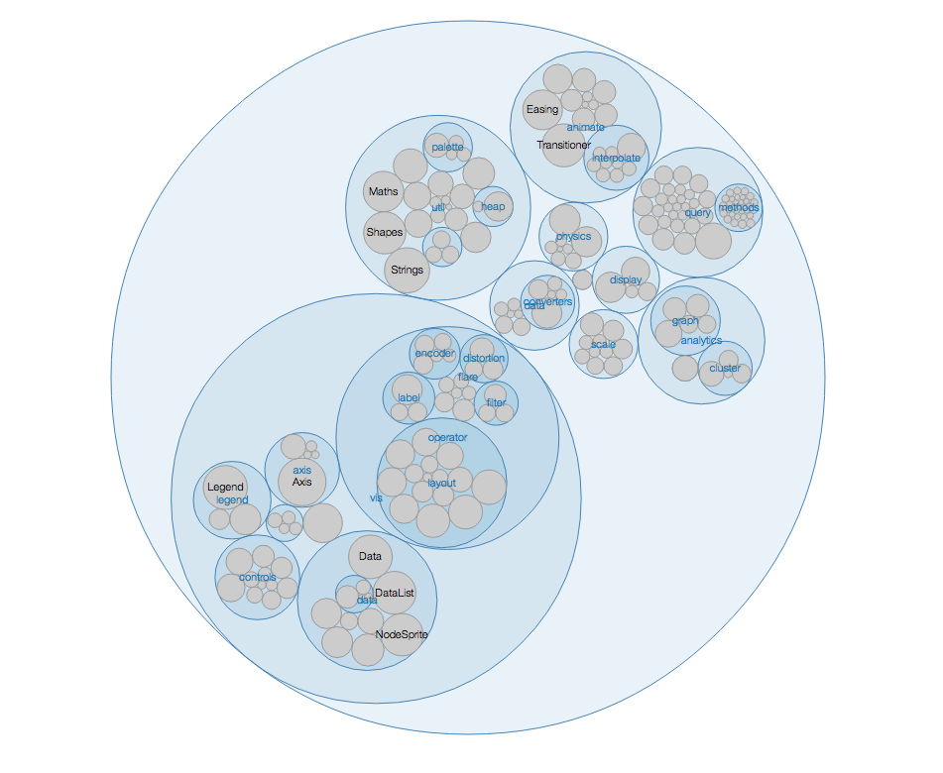

Slide 34
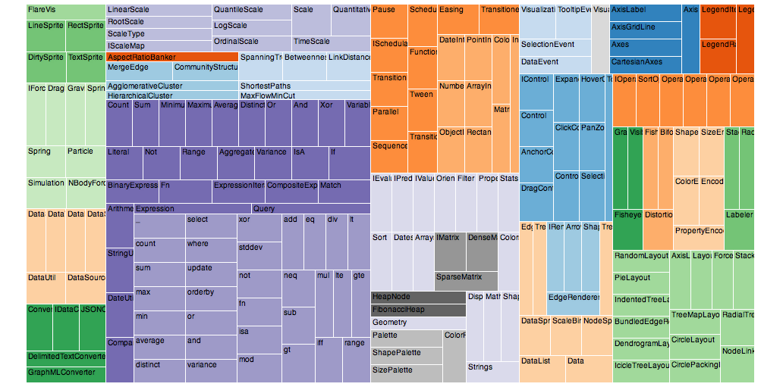

Slide 35
Future directions
Analysis dashboard tools
Legacy data

Slide 36
Project team
Jason Casden
Joyce Chapman
Rob Rucker
Eric McEachern
Rusty Earl
Bret Davidson

Slide 37
Thanks!
Jason Casden
jason_casden@ncsu.edu
Bret Davidson
bret_davidson@ncsu.edu
http://www.lib.ncsu.edu/dli/projects/spaceassesstool
http://github.com/cazzerson/Suma

